Slide 1
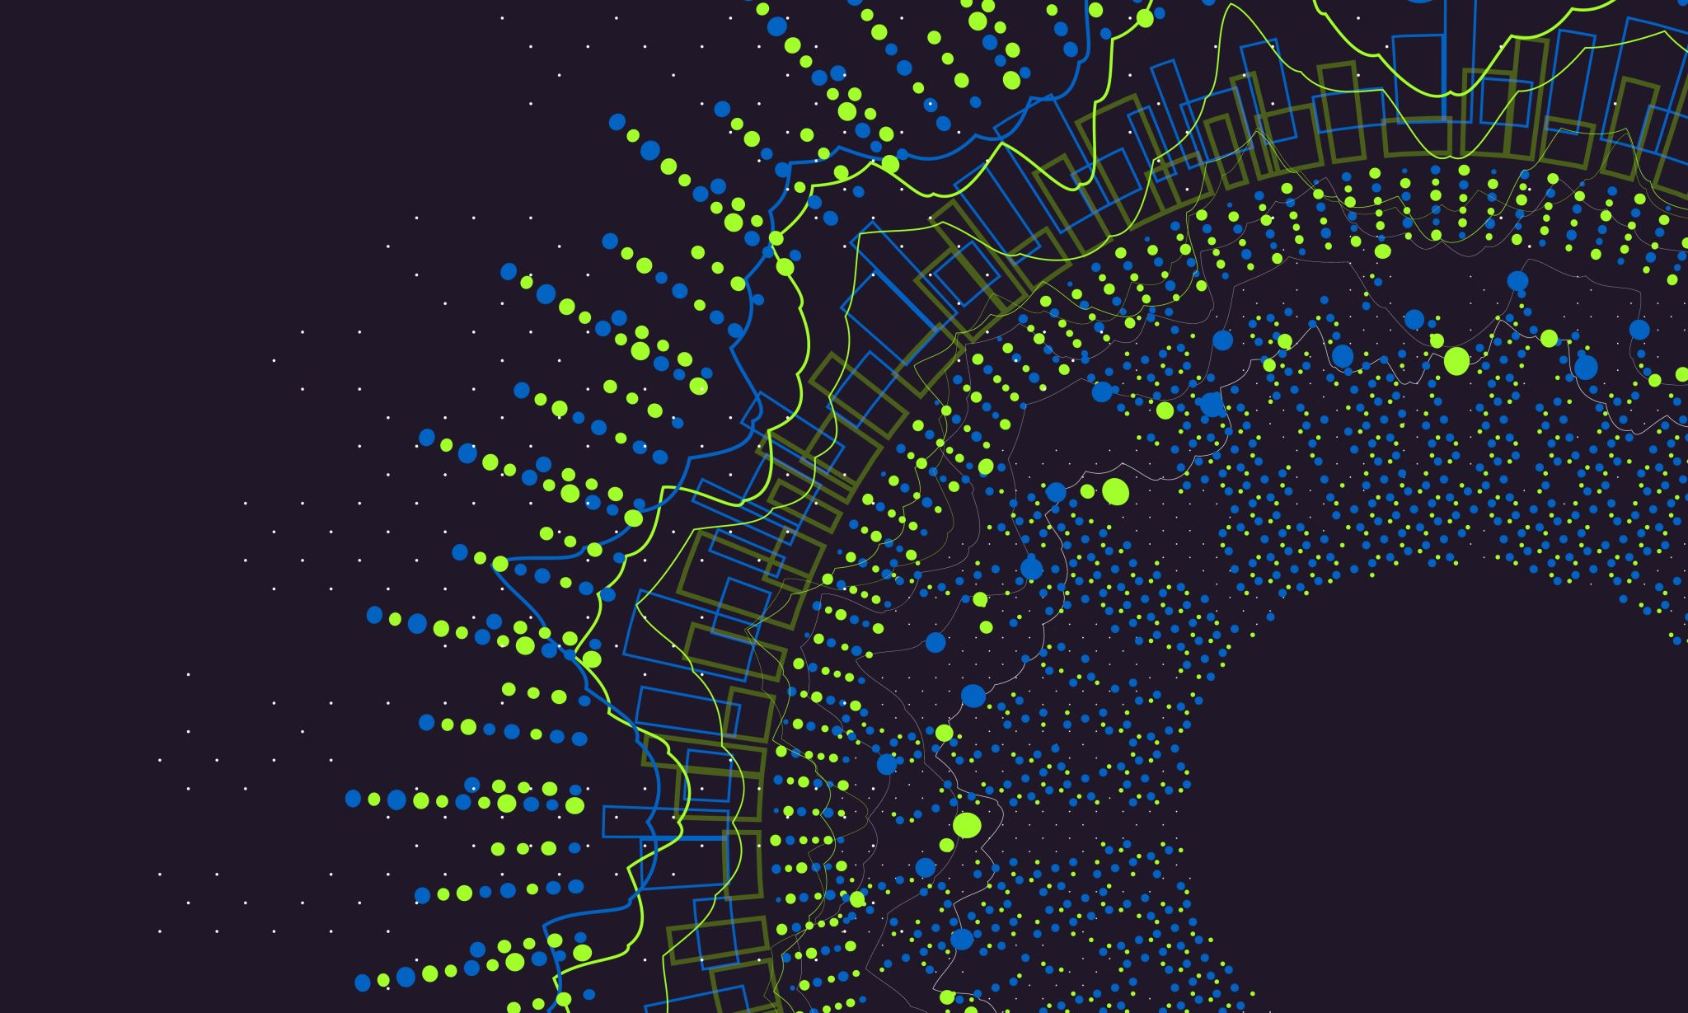
GenAI with LangChain

Slide 2
Why function calling?
Large Language Models (LLMs) are powerful at solving many types of problems. However, they are constrained by the following limitations:
They are frozen after training, leading to stale knowledge.
They can't query or modify external data.
Function calling can address these shortcomings. You can use function calling to define custom functions and provide these to a generative AI model.
For example, you could define a function get_weather that takes a location parameter and returns information about the weather conditions at that location.

Slide 4
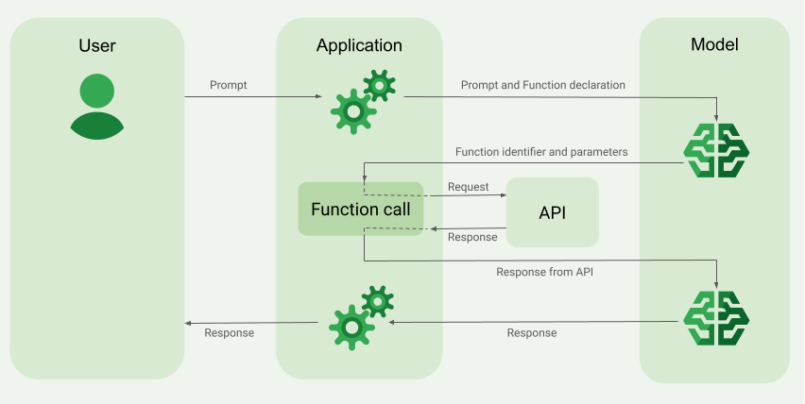
How function calling works?

Slide 5
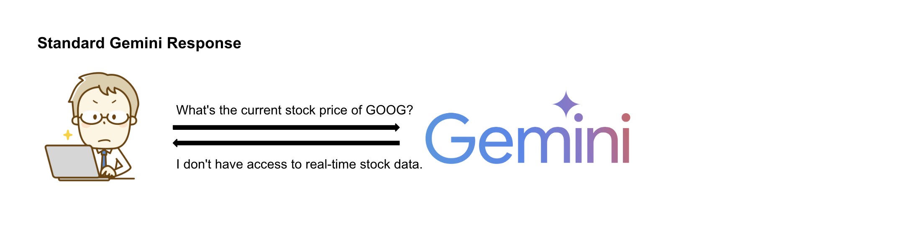
Function calling with Gemini

Slide 6
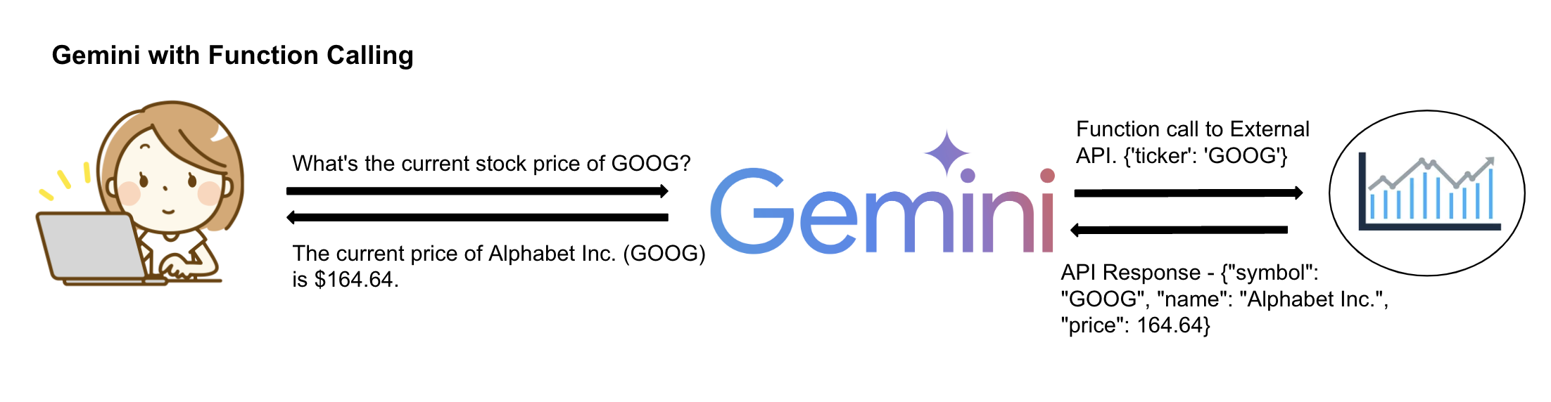
Function calling with Gemini

Slide 7
Which gemini models support function calling?
Model | Version | Function calling launch stage | Support for parallel function calling | Support for forced function calling
Gemini 1.0 Pro | gemini-1.0-pro-001 | General Availability | No | No
Gemini 1.0 Pro | gemini-1.0-pro-002 | General Availability | No | No
Gemini 1.5 Flash | gemini-1.5-flash-001 | General Availability | Yes | No
Gemini 1.5 Pro | gemini-1.5-pro-001 | General Availability | Yes | Yes

Slide 8
Parallel Function Calling
Parallel function calling allows you to fan out and parallelize your API calls or other actions that you perform in your application code, so you don't have to work through each function call response and return one-by-one!
In recent versions of specific Gemini Pro models (from May 2024 and on), Gemini has the ability to return two or more function calls in parallel (i.e., two or more function call responses within the first function call response object).

Slide 9
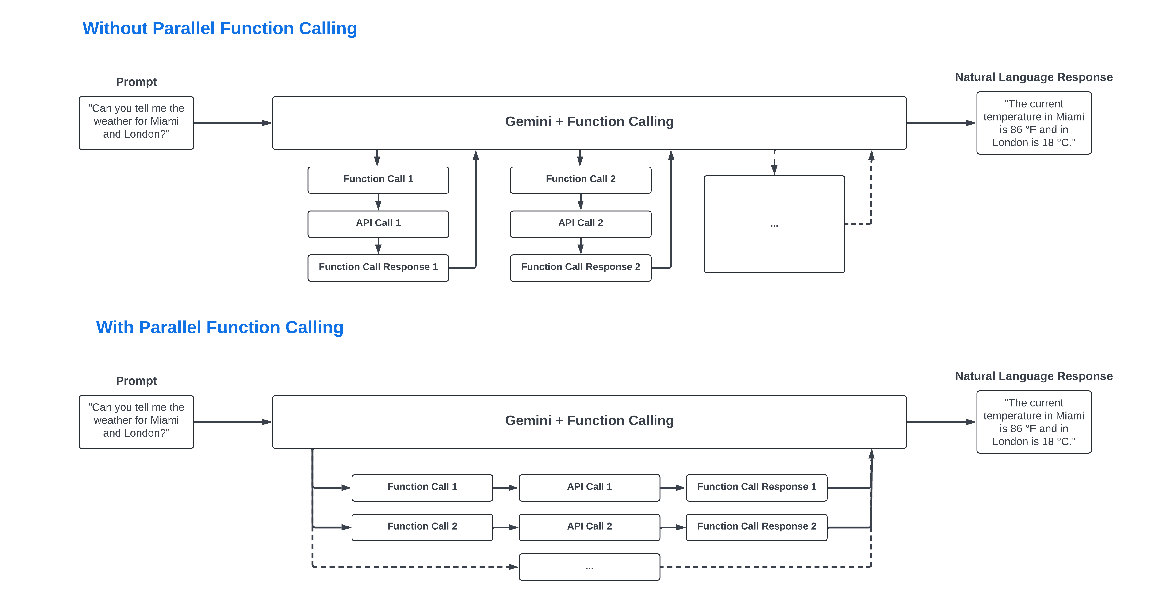
Parallel Function Calling

Slide 10
Benefits of function calling
Native framework: Function Calling is a native framework in Gemini, so there's no need to enable additional APIs or install extra packages.
Time savings: No need to write custom code to call, parse, and synthesize information from multiple APIs.
Simplified interaction with generative AI models: Gemini handles the complex task of understanding the user's intent, predicting function calls, extracting relevant function parameters, and generating natural language summaries.
Versatility: Easily extend capabilities by adding more function calls for different APIs and tailoring it to your needs.

Slide 11
Best Practices for Function Calling
Function name
Don't use period (.), dash (-), or space characters in the function name. Instead, use underscore (_) characters or any other characters.
Function description
Write function descriptions clearly and verbosely. For example, for a book_flight_ticket function:
The following is an example of a good function description: book flight tickets after confirming users' specific requirements, such as time, departure, destination, party size and preferred airline
The following is an example of a bad function description: book flight ticket

Slide 12
Best Practices for Function Calling
Function parameters
Write clear and verbose parameter descriptions, including details such as your preferred format or values. For example, for a book_flight_ticket function:
The following is a good example of a departure parameter description: Use the 3 char airport code to represent the airport. For example, SJC or SFO. Don't use the city name.
The following is a bad example of a departure parameter description: the departure airport
If possible, use strongly typed parameters to reduce model hallucinations. For example, if the parameter values are from a finite set, add an enum field instead of putting the set of values into the description. If the parameter value is always an integer, set the type to integer rather than number.

Slide 13
Best Practices for Function Calling
User prompt
For best results, prepend the user prompt with the following details:
Additional context for the model-for example, You are a flight API assistant to help with searching flights based on user preferences.
Details or instructions on how and when to use the functions-for example, Don't make assumptions on the departure or destination airports. Always use a future date for the departure or destination time.
Instructions to ask clarifying questions if user queries are ambiguous-for example, Ask clarifying questions if not enough information is available.

Slide 14
LangChain
Development: Build your applications using LangChain's open-source building blocks, components, and third-party integrations. Use LangGraph to build stateful agents with first-class streaming and human-in-the-loop support.
Productionization: Use LangSmith to inspect, monitor and evaluate your chains, so that you can continuously optimize and deploy with confidence.
Deployment: Turn your LangGraph applications into production-ready APIs and Assistants with LangGraph Cloud.

Slide 15
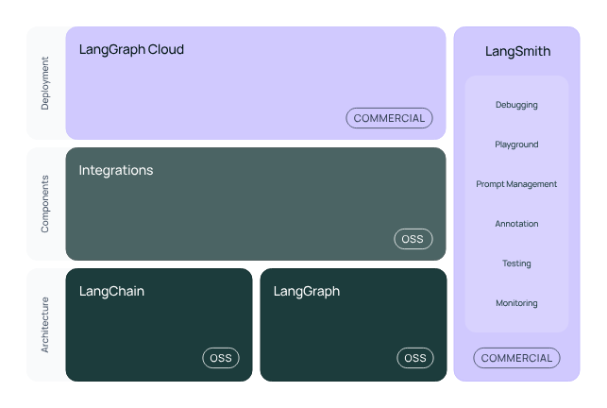
LangChain

Slide 16

LangChain Libraries
langchain-core: Base abstractions and LangChain Expression Language.
langchain-community: Third party integrations.
Partner packages (e.g. langchain-openai, langchain-anthropic, etc.): Some integrations have been further split into their own lightweight packages that only depend on langchain-core.
langchain: Chains, agents, and retrieval strategies that make up an application's cognitive architecture.
LangGraph: Build robust and stateful multi-actor applications with LLMs by modeling steps as edges and nodes in a graph. Integrates smoothly with LangChain, but can be used without it.
LangServe: Deploy LangChain chains as REST APIs.
LangSmith: A developer platform that lets you debug, test, evaluate, and monitor LLM applications.

Slide 17
Retrieval Augmented Generation
Anshu Pandey

Slide 18
Embeddings
Embeddings are a way to convert complex data like texts, images, or any kind of information into a list of numbers (a vector) that a computer can work with.

Slide 19
Vector Embeddings
Vector embeddings are a way of converting items like words, sentences, or even entire documents into a series of numbers (a vector) so that a computer can understand and work with them.
These numbers represent the meaning of the items and their relationship to each other, allowing the computer to perform tasks such as finding similar words or understanding the topic of a document.

Slide 20
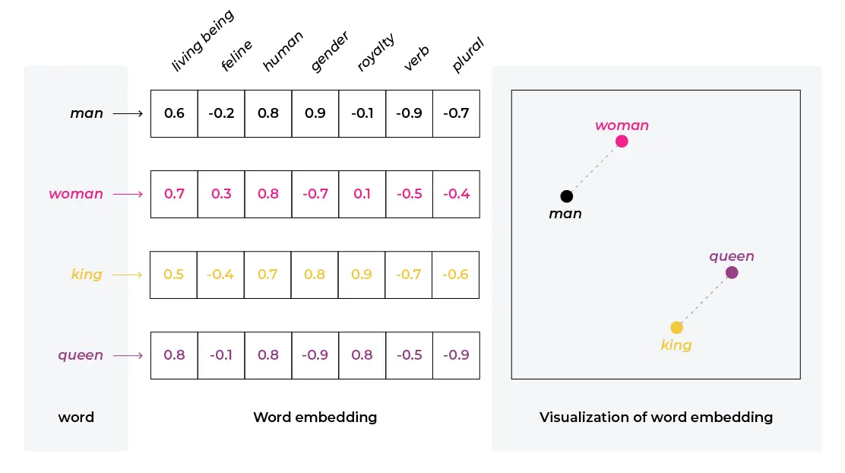
Text Embeddings
A semantic relationship refers to the way words or phrases relate to each other in terms of meaning.
Example: Word2Vec is a popular model for generating word embeddings. If you take words like "king" and "man" and perform vector arithmetic by subtracting "man" from "king" and then adding "woman," you often get a result close to the vector for "queen."

Slide 21
Vector Databases Vector databases are specialized databases optimized for storing and querying vector embeddings. These embeddings are high-dimensional vectors that represent complex data in a form that machines can understand and process.

Slide 22
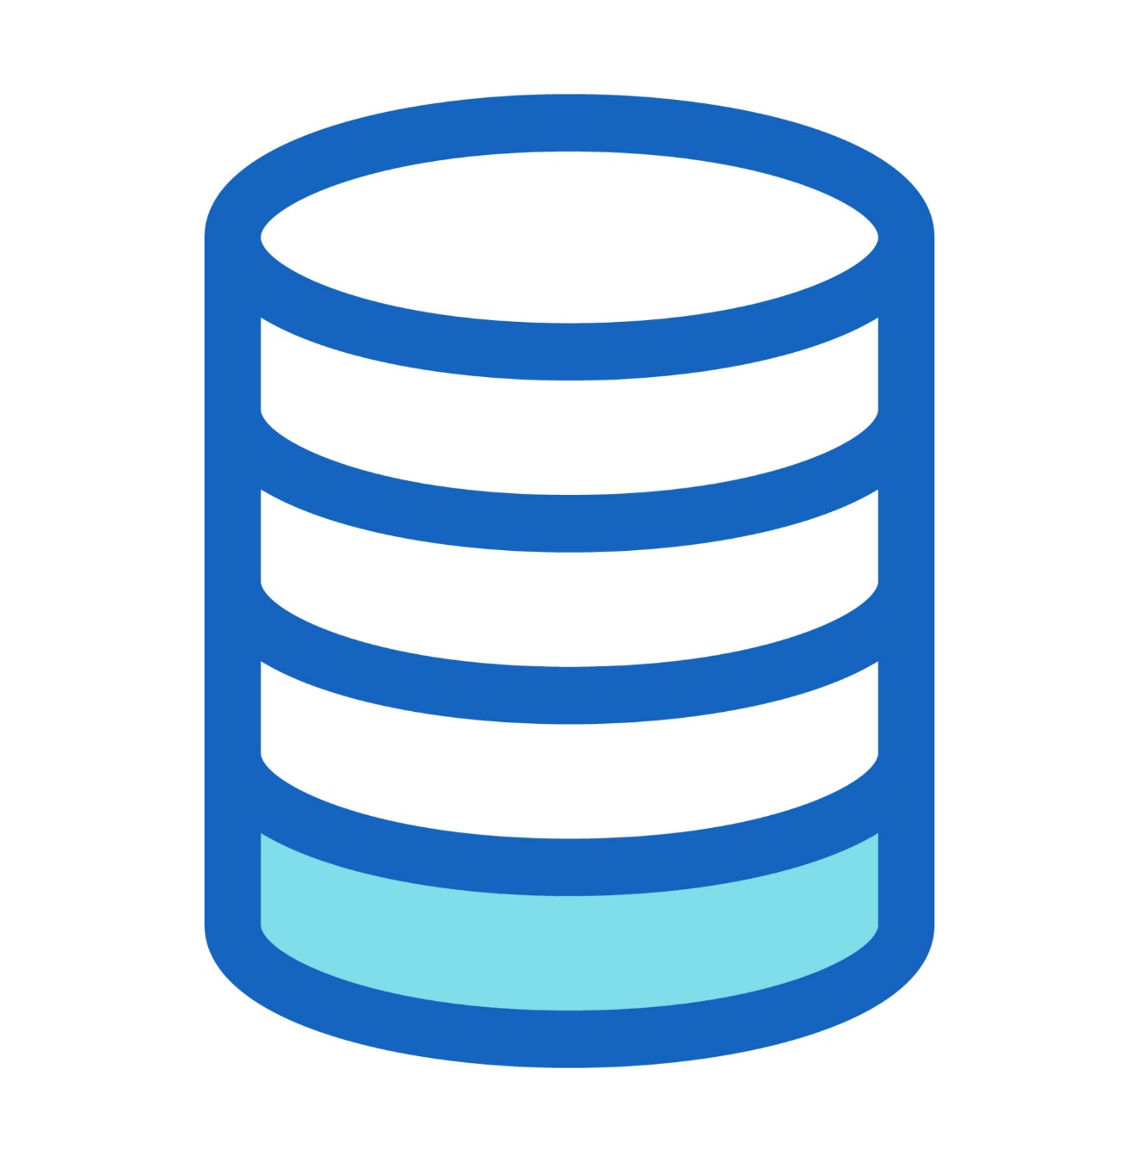
Role of Vector Database in AI
In machine learning, particularly in areas like natural language processing (NLP) and computer vision, data is often transformed into vectors using models like word embeddings or image embeddings.
Vector databases allow for efficient storage and retrieval of these embeddings, enabling features like similarity search, where you can query database with a vector and find other vectors that are similar to it.
Vector databases are optimized for vector-specific operations, such as cosine similarity, Euclidean distance, and nearest neighbor search.
This all makes them suitable for applications like recommendation systems, image recognition, and semantic text search.

Slide 23
Vector Databases
 | Vector Database | Traditional Database
Data Representation | Stores data as high-dimensional vectors, representing complex relationships and similarities between data points. | Stores data in structured formats such as tables with rows and columns, often relying on relational models.
Querying Approach | Utilizes similarity-based queries, where vectors closely resembling a query vector are retrieved based on distance or similarity metrics. | Typically uses exact matching queries based on specified criteria, such as SQL queries.
Data Types | Capable of handling diverse data types including text, images, audio, and more, by converting them into numerical representations (vectors). | Suited for structured data types like text, numbers, and dates.
Indexing & Retrieval | Utilizes specialized indexing techniques like k-NN, LSH, or HNSW to efficiently retrieve vectors based on similarity metrics. | Relies on indexing methods optimized for structured data, such as B-tree or hash-based indexing.

Slide 24

Pinecone
Pinecone is a vector database specifically designed for machine learning applications.
It's built to handle the complexities of vector search at scale, enabling efficient management and retrieval of high-dimensional data.
Pinecone is often used in scenarios where similarity search is essential, such as recommendation systems, image and text retrieval, and anomaly detection.

Slide 25

Chroma
Chroma is an open-source vector database designed specifically for storing and retrieving high-dimensional vector data.
Unlike traditional relational databases, which struggle with vector representations, Chroma is optimized for vector operations and supports efficient nearest neighbor search, a critical capability for many AI applications.

Slide 26
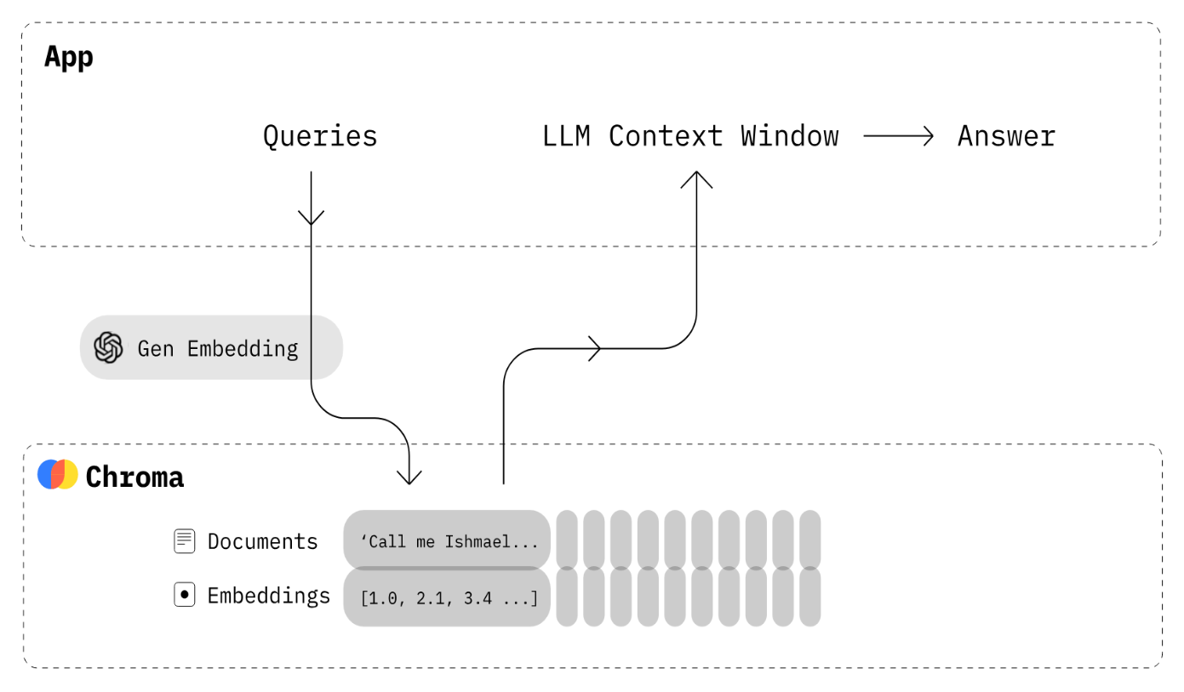
Key features of Chroma
Key Features
Open-source and Free: Chroma is free to use and modify, allowing for customization and community-driven improvements.
Scalability and Performance: Chroma handles large datasets efficiently and offers fast retrieval times for nearest neighbor searches.
Flexibility: Chroma supports multiple storage options (DuckDB for standalone, Click House for scalability) and various embedding models (Sentence Transformers, OpenAI, Cohere, custom models).
Simplicity and Analysis: Chroma is user-friendly, with straightforward APIs and visualization tools to explore and analyze data relationships.
Cross-Platform Support: Chroma works on Linux, macOS, and Windows, offering easy integration with various development environments.

Slide 27

Vectara
Vectara is a cloud-based vector search platform designed for creating and managing sophisticated search and recommendation systems.
It's particularly geared towards enterprise-level applications, offering features and capabilities that support complex, high-volume search requirements.

Slide 31
Retriever-Augmented Generation (RAG)

Slide 32
Why RAG?
LMs can reason about wide-ranging topics, but their knowledge is limited to the public data up to a specific point in time that they were trained on.
If you want to build AI applications that can reason about private data or data introduced after a model’s cutoff date, you need to augment the knowledge of the model with the specific information it needs.
The process of bringing the appropriate information and inserting it into the model prompt is known as Retrieval Augmented Generation (RAG).

Slide 33
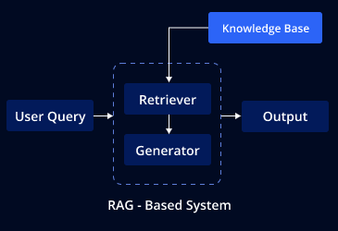
Understanding RAG
Hybrid Model : RAG is a hybrid model that brings together the strengths of both retrieval-based and generative approaches in NLP.
Retriever Component : The retriever is responsible for fetching relevant documents or data snippets that might contain the information needed to answer a question or address a query. This component typically uses techniques like semantic search to find documents that are contextually similar to the input query.
Generator Component : The generator then takes the context provided by the retriever and generates a coherent and contextually accurate response. This part of the model is often a large language model, similar to those used in generative AI for text generation.

Slide 34
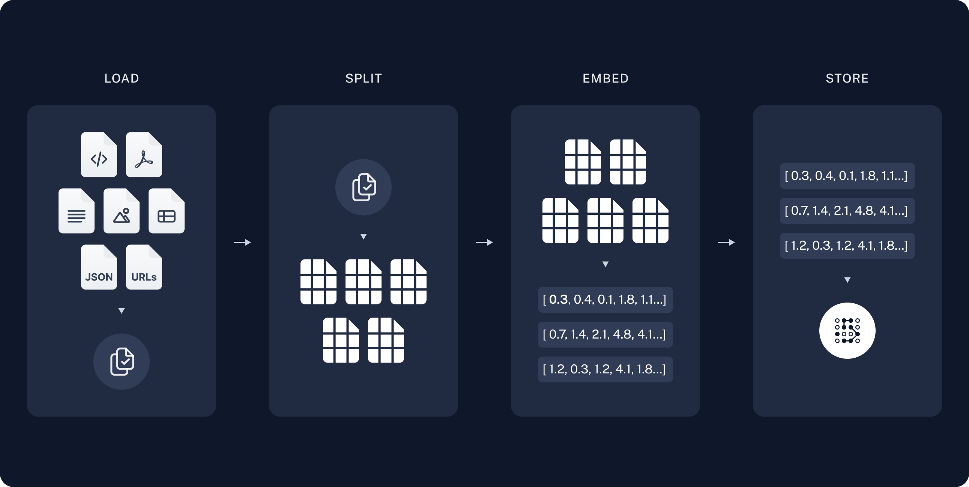
Architecture of RAG - 1
Indexing: a pipeline for ingesting data from a source and indexing it. This usually happens offline.
It’s a 3 step process:
Load: First we need to load our data. This is done with DocumentLoaders.
Split: Text splitters break large Documents into smaller chunks. This is useful both for indexing data and for passing it in to a model, since large chunks are harder to search over and won’t fit in a model’s finite context window.
Store: We need somewhere to store and index our splits, so that they can later be searched over. This is often done using a VectorStore and Embeddings model.

Slide 35
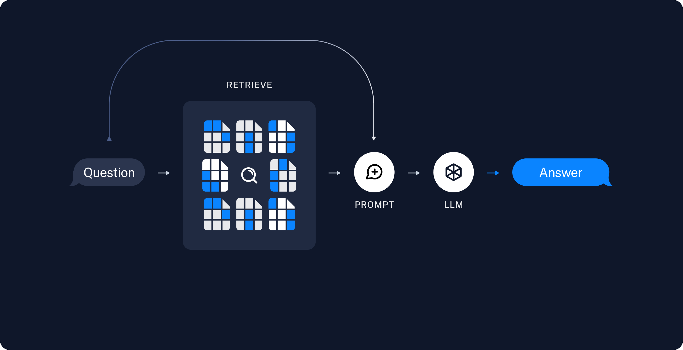
Architecture of RAG - 2
Retrieval and generation: the actual RAG chain, which takes the user query at run time and retrieves the relevant data from the index, then passes that to the model.
It’s a 2 step process:
Retrieve: Given a user input, relevant splits are retrieved from storage using a Retriever.
Generate: A ChatModel / LLM produces an answer using a prompt that includes the question and the retrieved data

Slide 36
How RAG works?
1
Input Processing
When a query or a question is input into a RAG model, the retriever first processes this input.
Data Retrieval
2
The retriever searches a database or a document set to find relevant information.
This database could be a pre-compiled corpus of text, like Wikipedia or a specialized knowledge base.
3
Context Integration
Large language models achieve impressive performance on diverse tasks, such as translation, summarization, conversation, and even coding.
Response Generation
4
The generator model, using both the original query and the context from the retrieved documents, generates a response that is informed by this additional data.

Slide 37

Applications of RAG
Question Answering Systems : RAG is particularly effective in question-answering systems where the answer might not be contained in a single document or may require synthesis from multiple sources.
Chatbots and Virtual Assistants : Improving the quality of responses in conversational AI by providing more accurate and detailed answers.
Information Retrieval : Enhancing search systems to provide more relevant results by combining retrieval with generation.

